Slide 1


Simplifying your path to Portugal

Slide 2







Maria
Background: student from Brazil
Challenges: Facing complex visa application process
Goals: Successfully obtain a visa, start her academic journey in Portugal

Slide 3


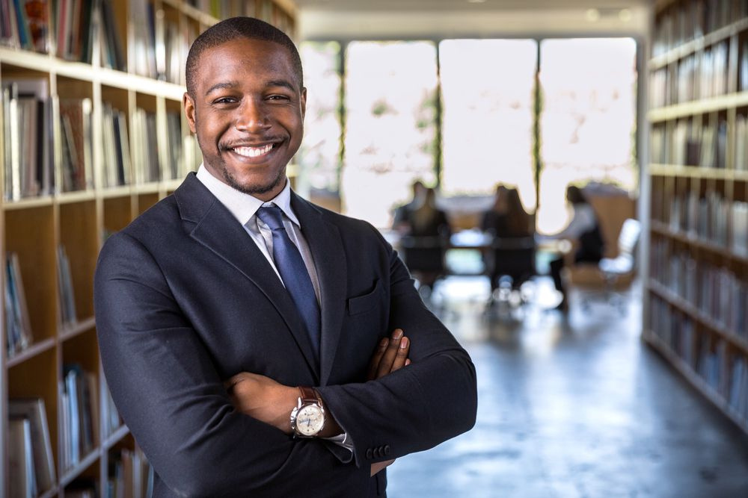


Ricardo
Background: Experienced immigration lawyer.
Challenges: Struggling to reach clients due to limited online presence.
Goals: Reach more clients. Increase visibility and credibility.

Slide 5
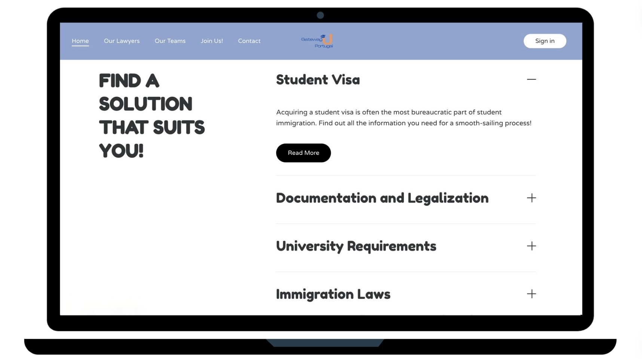

Slide 6
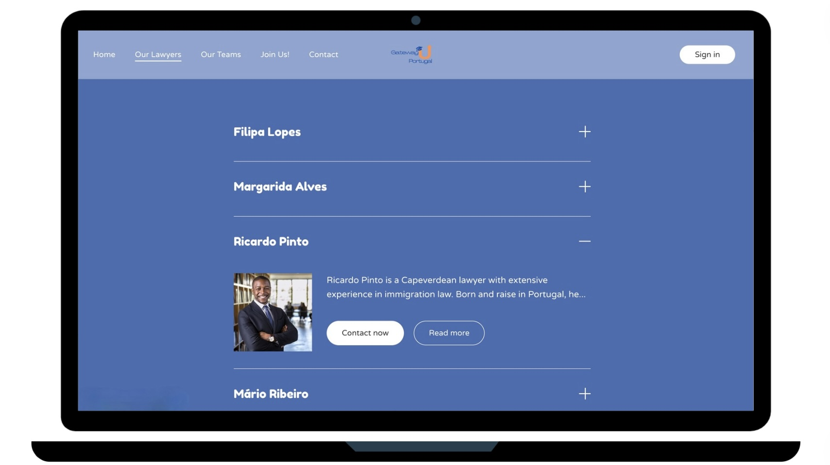

Slide 7
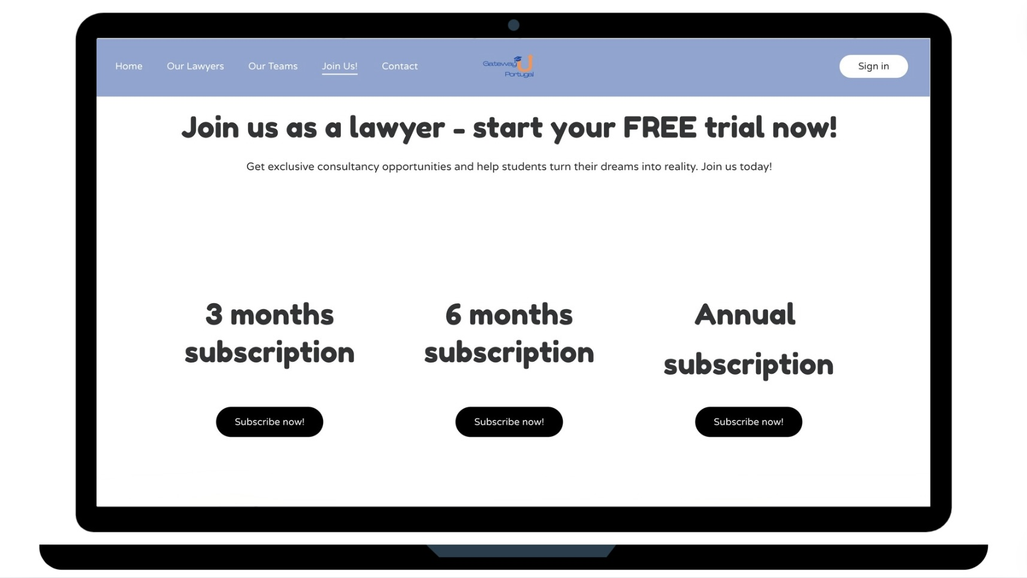

Slide 8


centralized platform
increased visibility for lawyers
reliable information for students
innovative and user-friendly interface

Slide 9

50 000
Students applying for VISA to come to Portugal

Slide 10




Direct contact with lawyers /
Personalized information
Immigration focused
Intuitive and user-friendly interface

Slide 11


INNITIAL ROLLOUT
FULL LAUNCH
15 000€
150 000€
EXPECTED RETURN
500 000€
by 2027

Slide 12
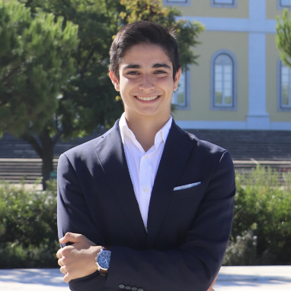
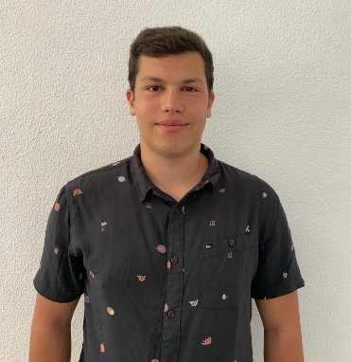
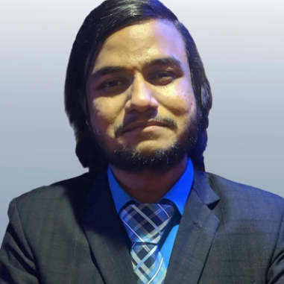
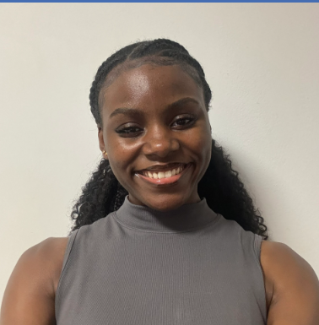
Meet our Team
João Capitão
Francisco Fogaça
Tausif Ahmad
Lara Menezes
Chief Executive Officer
Chief Financial Officer
Marketing Specialist
Communication Specialist

Slide 13


THANK YOU!

Slide 14
